Slide 1




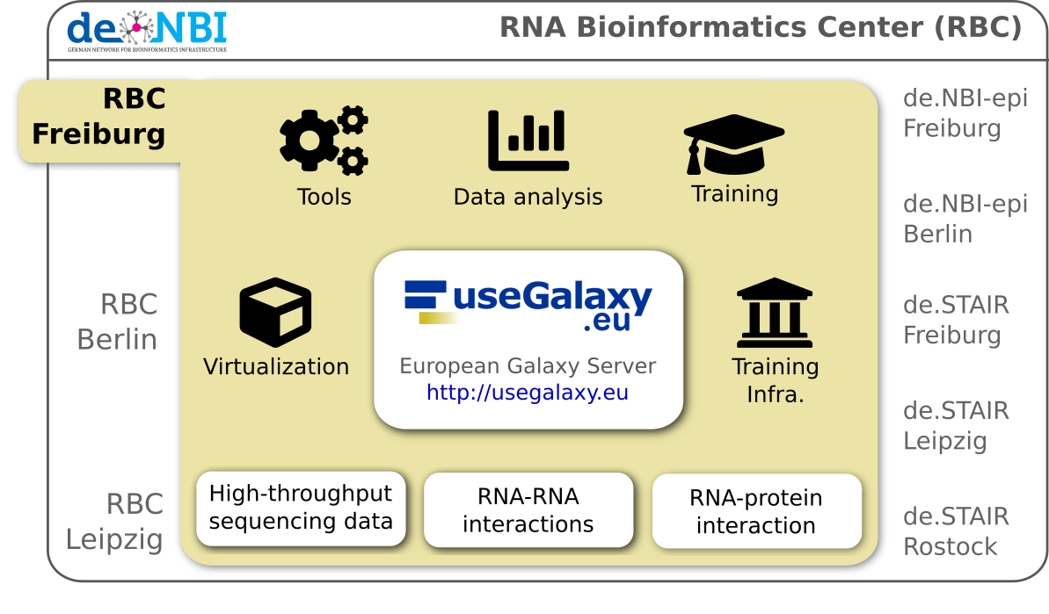
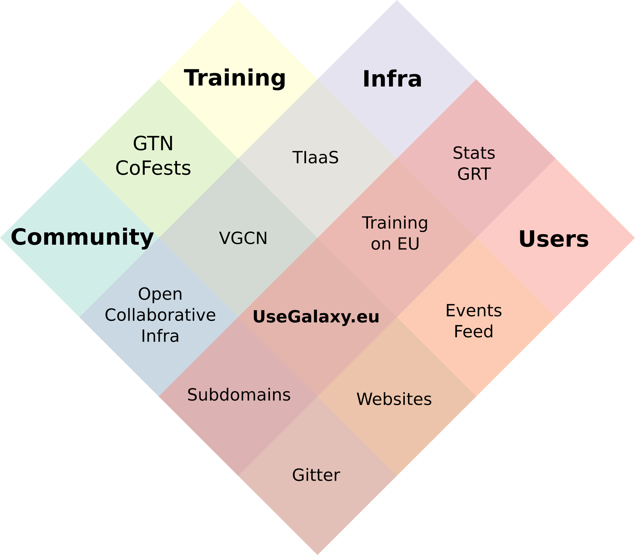
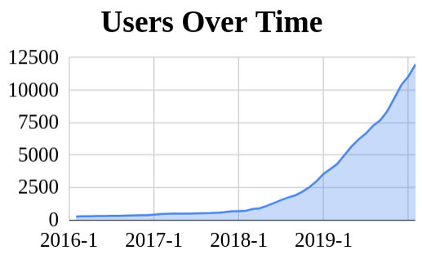
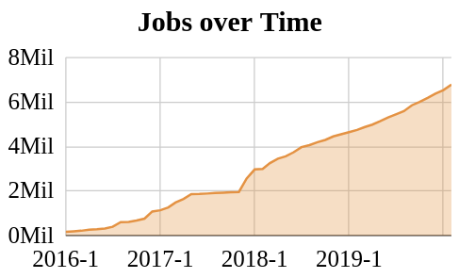

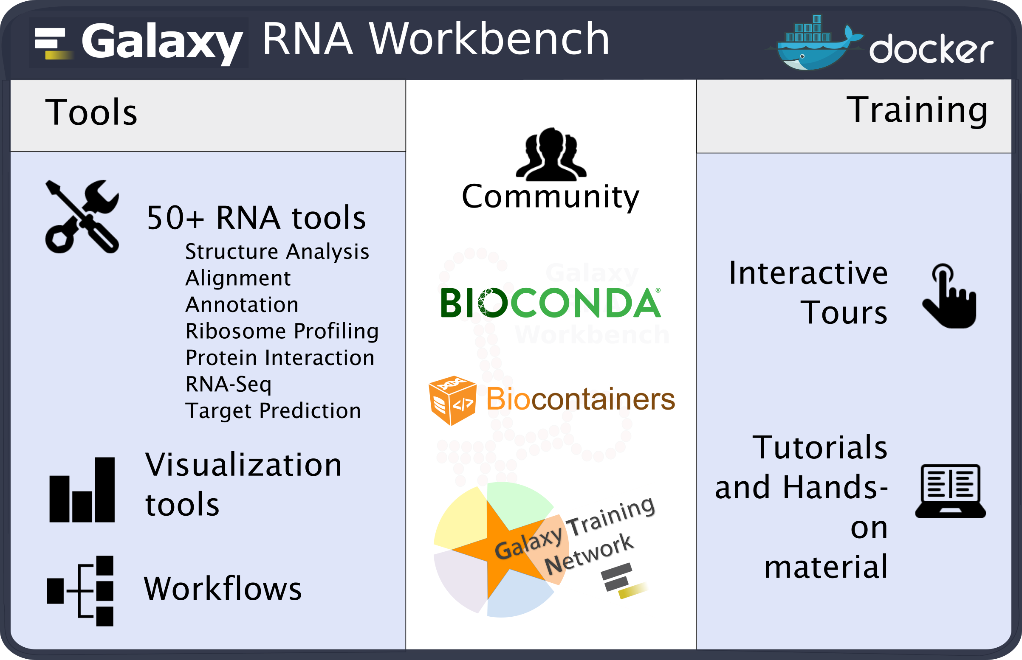


RBC-FR
RNA Bioinformatics Center
Freiburg Galaxy Team
Fkz 031A538A
Bérénice Batut, Anika Erxleben, Jan Leendertse, Alireza Khanteymoori, Gianmauro Cuccuru, Anup Kumar, Wolfgang Maier,
Rolf Backofen, Chair of Bioinformatics, University of Freiburg, Germany
RBC Freiburg
Progress report
Services​
Opening of the Freiburg Galaxy Server to all European ​
researchers, a huge step for open, accessible and reproducible​ research in Germany and Europe!
Launch of the ELIXIR Galaxy community​
Publication of the Bioconda manuscript in Nature Methods​
Recognition of Biocontainers as one pillar of the ELIXIR tools​
Expansion of de.NBI Cloud FR to 3.5k cores, 15TB RAM​
Major events ​
Galaxy Community Conference (GCC), Freiburg ​
> 230 participants, 5 continents​
Gallantries RNA-seq workshop ​
> 50 participants ​
Training (2018-2020)​
> 75 training events​
> 2,700 trainees
de.NBI services
de.NBI Training and education
Workshops and mentoring
Twice per year a full-week hands-on high-throughput sequencing data analysis workshop
New workshops for Single-cell and Machine learning
Training around the world on demand for data analysis, developers and administrators
On-site mentoring
HTS lectures and Galaxy courses for Master students
Online training material
Main contributors of Galaxy training material
Online: https://training.galaxyproject.org
Freely accessible online material designed for both self-training and workshops
> 130 tutorials with hands-on and/or slides
Training Infrastructure-as-a-Service (TIaaS)
Dedicated compute resources for Galaxy trainings
In past 6 months - > 1,700 trainees, > 35 events, 4 continents
> 3,000 tools
> 18,000 workflows
Our flagship service is our Galaxy server (https://usegalaxy.eu)
which is the biggest Galaxy instance in Europe, and one of the biggest worldwide, powered by de.NBI cloud and GDPR compliant.
Virtualization
RBC Freiburg is actively involved in making software user-accessible and cloud-ready. We joined and are leading the Bioconda and Biocontainers communities, to fix the software deployment problem once and for all. We also developed Galaxy Docker, a production-ready, scalable Galaxy instance with customized tool sets. We provide the RNA-workbench flavour for all RNA related research.
Publications
Wibberg, D, et al. (2019), The de.NBI/ELIXIR-DE training platform-Bioinformatics training in Germany and across Europe within ELIXIR, F1000Research, Vol. 8.
Miladi, M. et al. (2019) GraphClust2: annotation and discovery of structured RNAs with scalable and accessible integrative clustering, Oxford University Press, Vol. 8, GigaScience.
Fallmann, J. et al. (2019) The RNA workbench 2.0: next generation RNA data analysis, Nucleic acids research, Oxford University Press.
Afgan, E. et al. (2018) The Galaxy platform for accessible, reproducible and collaborative biomedical analyses: 2018 update. Nucleic Acids Research, 46.
Batut,B. et al. (2018) Community-Driven Data Analysis Training for Biology. Cell Systems, 6, 752–758.e1.
Grüning, B. et al. (2018) Bioconda: sustainable and comprehensive software distribution for the life sciences. Nature Methods, 15, 475–476.
Grüning, B. et al. (2018) Practical Computational Reproducibility in the Life Sciences. Cell Systems, 6, 631–635.
General information on the project
4 staff paid by de.NBI grant + 1 cloud staff +
1 cloud certification staff + 3 other staff involved
www.denbi.de

